Slide 1

The Mindful Beauty Shopping with a Conscience - Because Beauty Shouldn't Cost the Planet.
Coder: Victoria Dablah

Slide 2

About the App
An app designed for shoppers who want to be mindful of the ethical and sustainability practices behind their favorite skincare brands. Using real data from The Good Shopping Guide, The Mindful Beauty allows users to explore 47 different skincare brands, and their ratings based on various criteria, including Animal Welfare, Human Rights, Genetic Modification, and more. Users will also be able to compare brands, access detailed scores for each criterion, and filter brands according to specific criteria or ratings.
Tools: Python, Streamlit

Slide 3
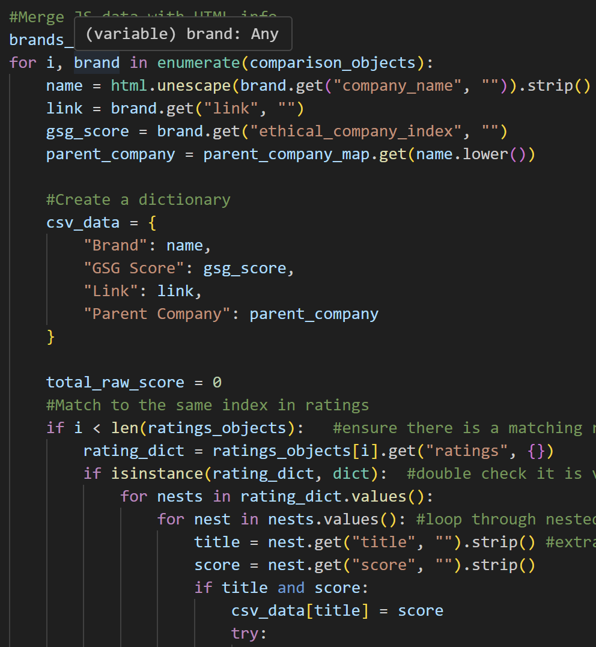
What's next?
I plan to integrate Streamlit and increase the scope of my project by including fashion brands, stay tuned!

